Slide 1
Application Delivery Fundamentals 2.0 B: Java
Spring Integration

Slide 2
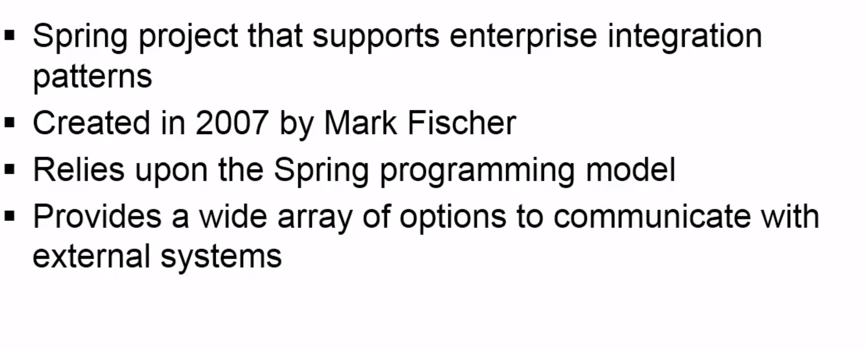
Spring Integration

Slide 3
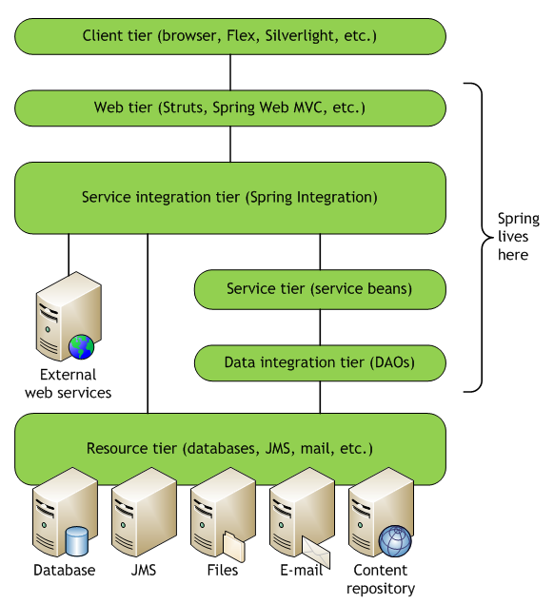
Spring Integration

Slide 4
Spring Integration Framework
Spring Integration provides an extension of Spring’s plain old Java object (POJO) programming model to support the standard integration patterns.
Spring Integration works in terms of the fundamental idioms of integration, including messages, channels, and endpoints.
It enables messaging within Spring-based applications and integrates with external systems via Spring Integration’s adapter framework.

Slide 5
Spring Integration Framework
The adapter framework provides a higher level of abstraction over Spring’s existing support for remote method invocation, messaging, scheduling and much more.

Slide 6
Exploring the Alternatives
Mule provides a lightweight container and leverages a simple XML configuration file and Plain Old Java Objects (POJOs).
ServiceMix is based on the Java Business Integration (JBI) standard and now supports OSGI.
OpenESB is (http://open-esb.dev.java.net) the integration offering from Oracle based on the JBI and J2EE standards.
OpenESB is designed to live in a J2EE application server like GlassFish.

Slide 7
Spring Integration Basics
Spring Integration adds essentially three components to the core Spring Framework: messages, message channels, and endpoints.

Slide 8
Goals
Spring Integration is motivated by the following goals:
Provide a simple model for implementing complex enterprise integration solutions.
Facilitate asynchronous, message-driven behavior within a Spring-based application.
Promote intuitive, incremental adoption for existing Spring users.

Slide 9
Principles
Spring Integration is guided by the following principles:
Components should be loosely coupled for modularity and testability.
The framework should enforce separation of concerns between business logic and integration logic.
Extension points should be abstract in nature but within well-defined boundaries to promote reuse and portability.

Slide 10
Message

Slide 11
Messages
A message is a generic wrapper for any Java object combined with metadata used by Spring Integration to handle the object.
public interface org.springframework.integration.Message<T> {
MessageHeaders getHeaders();
T getPayload();
}

Slide 12
Headers
The org.springframework.integration.MessageHeaders object is a String/Object Map that typically maintains values for message housekeeping chores.
MessageHeaders are immutable and are usually created using the MessageBuilder API.
There are a number of predefined entries (headers), including id, timestamp, correlation id, and priority.
The headers can maintain values required by the adapter endpoints.
Headers may be used any key/value pair required by the developer.

Slide 13
Payloads
The message payload can be any POJO.
Transformation support allows converting any payload into any type of format required by the message endpoint.

Slide 14
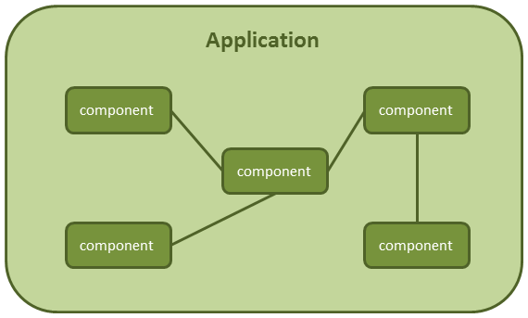
Message

Slide 15
Message Channels
A message channel is the component through which messages are moved.
Message publishers send messages to the channel, and message consumers receive messages from the channel.
The channel effectively decouples the producer and consumer.
There are two types of messaging scenarios:
point-topoint, in which a message is received only once, by a single consumer;
publish/subscribe, in which one or more consumers can attempt to receive a single message.

Slide 16
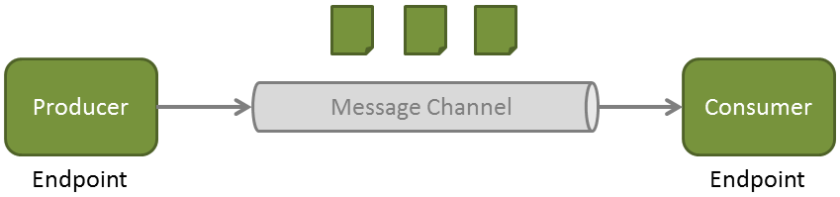
Message Channel

Slide 17
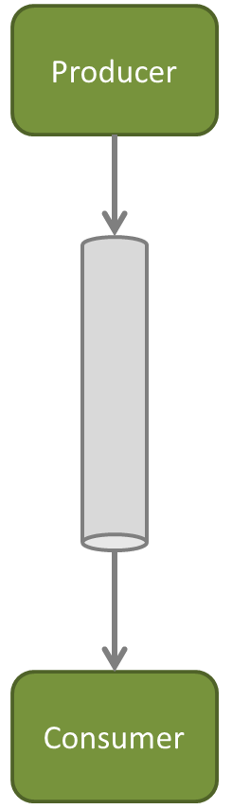
Point to Point

Slide 18
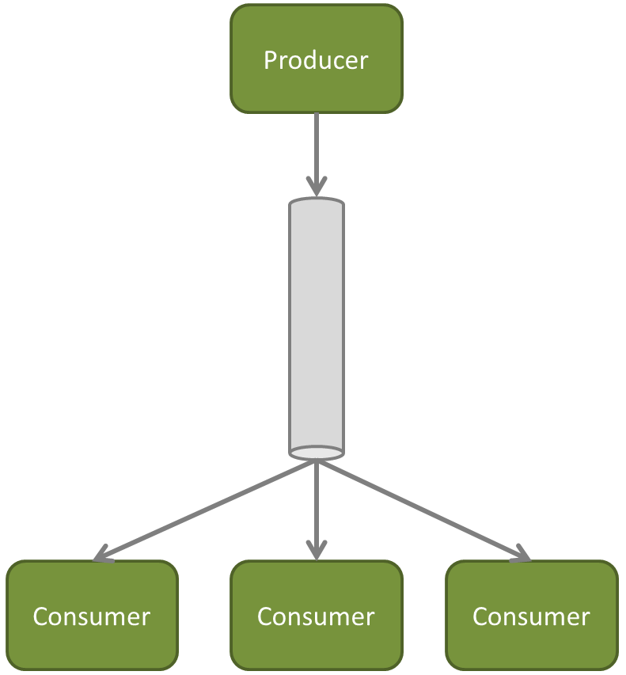
Publish and Subscribe

Slide 19
Message Channels

Slide 20
Message Channels

Slide 21
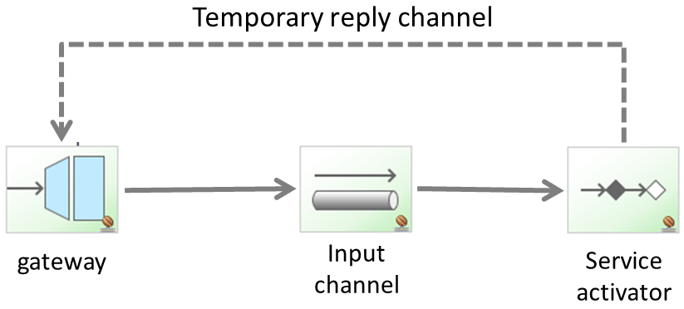
Temporary Reply Channel

Slide 22
Channel Adapter

Slide 23
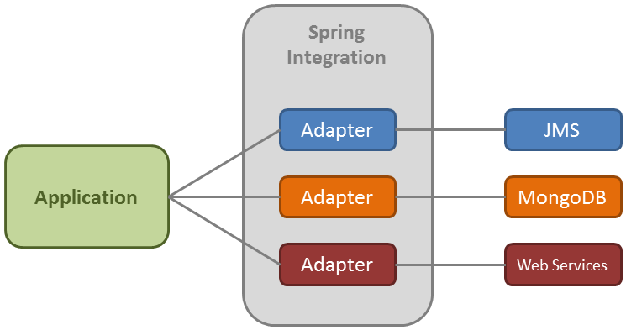
Channel Adapter

Slide 24
Endpoint

Slide 25
Message Endpoints
A message endpoint is the abstraction layer between the application code and the messaging framework.
An endpoint broadly defines all the types of components used in Spring Integration.
It handles such tasks as producing and consuming messages, as well as interfacing with application code, external services, and applications.
When data travels through a Spring Integration solution, it moves along channels from one endpoint to another.
Data can come into the framework from external systems using a specific type of endpoint called an adapter.

Slide 26
Message Endpoints
The main endpoint types supported by Spring Integration are as follows:
Transformer: Converts the message content or structure.
Filter: Determines if the message should be passed to the message channel.
Router: Can determine which channel to send a particular message based on its content.
Splitter: Can break an incoming message into multiple messages and send them to the appropriate channel.

Slide 27
Message Endpoints
Aggregator: Can combine multiple messages into one. An aggregator is more complex than a splitter often required to maintain state.
Service activator: Is the interface between the message channel and a service instance, many times containing the application code for business logic.
Channel adapter: Is used to connect the message channel to another system or transport.

Slide 28
Integration with External Systems
Spring Integration provides a number of endpoints used to interface with external systems, file systems etc.
Integration with External Systems
AMQP (RabbitMQ)
Spring ApplicationEvents
Feed (RSS, ATOM, …)
• File
• FTP
• GemFire
• HTTP
• JDBC
• JMS
• JMX
• JPA (Hibernate, OpenJPA, …)
• Mail
• MongoDB
• MQTT
• Redis
• Resource
• RMI
• SFTP
• Stream
• Syslog
• TCP
• Twitter
• UDP
• Web Services
• XMPP

Slide 29
Transformer

Slide 30
Filter

Slide 31
Router

Slide 32
Splitter

Slide 33
Aggregator

Slide 34
Service Activator

Slide 35
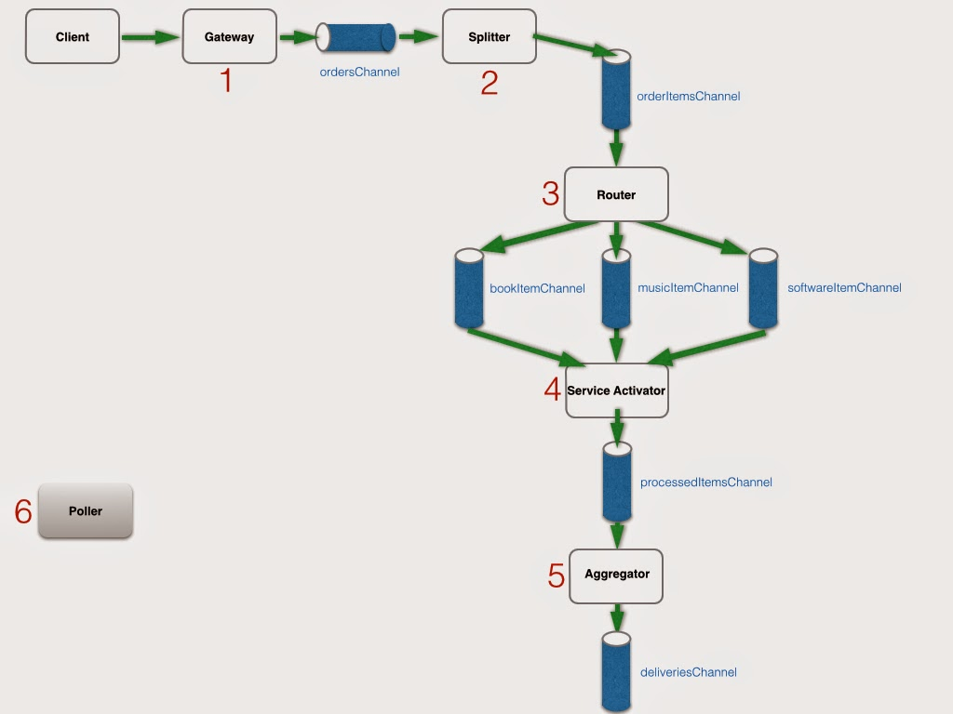
Spring Integration

Slide 36
Event-Driven Architecture
An event is a significant change in state.
An event-driven architecture, this event get sent or published to all interested parties.
The subscribing parties can look at the event and choose to respond or ignore it.
The response may include invoking a service, running a business process, or publishing another event.

Slide 37
Event-Driven Architecture
Event-driven architecture is loosely coupled, meaning that the publisher of the event has no knowledge of what the consumers do downstream after the event has been processed.
Spring Integration is well suited for this type of architecture, as it captures events as messages.
Event-driven architecture usually refers to simple event processing in which a published event leads to some downstream action.
This type of processing is well suited to performing a real-time flow of work.

Slide 38
Event-Driven Architecture
By contrast, complex event processing (CEP) usually involves evaluating an aggregation of events, typically coming from all levels of a business.
This may require analysis, correlation, and pattern matching to determine the appropriate action to be taken.
Business process management (BPM) is a typical use case for CEP.
There can be a number of different events that occur and only a certain combination of events will require a response.
Spring Integration has the basic building blocks for CEP, including routers and aggregators

Slide 39
Questions

Slide 40
Module Summary
Spring Integration Framework.
Message, Channel and Adapter
Understood the different Component Integration
Understood the Event-Driven Architecture

